Slide 1
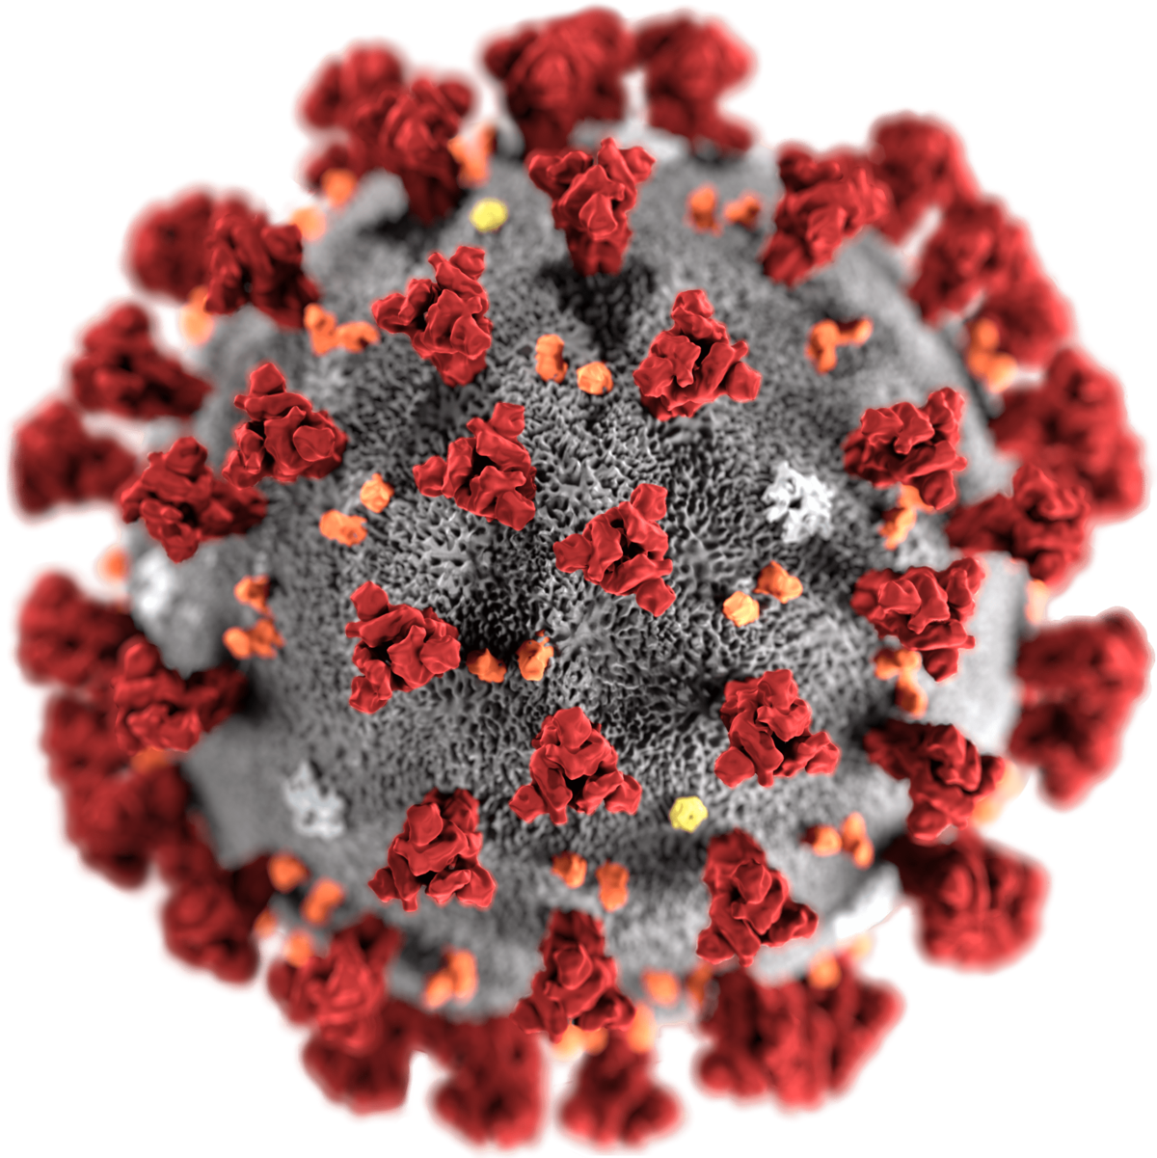
Detecting
Covid-19 From X-Rays
PRESENTED ON 08-03-2021

Slide 2
TOPIC OF CONTENT
Objective
Problem statement
Solution
Literature survey
Technical stack
Timeline

Slide 3
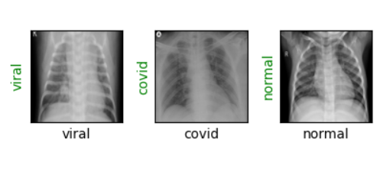
OBJECTIVE
To develop a fully automatic framework to detect COVID-19 using chest x-ray.
To develop a model that uses Machine learning to detect coronavirus disease 2019 (COVID-19) and distinguish it from normal and community acquired pneumonia affected x-rays.

Slide 4
PROBLEM STATEMENT
COVID-19 is posed as very infectious and deadly pneumonia type disease until recent time.
Novel coronavirus or SARS-COV-2 strain is responsible for COVID-19 and it has already shown the deadly nature of respiratory disease by threatening the health of millions of lives across the globe.
Clinical study reveals that a COVID-19 infected person may experience dry cough, muscle pain, headache, fever, sore throat and mild to moderate respiratory illness.
At the same time, it affects the lungs badly with virus infection. So, the lung can be a prominent internal organ to diagnose the gravity of COVID-19 infection using X-Ray and CT scan images of chest.
Despite having lengthy testing time, RT-PCR is a proven testing methodology to detect coronavirus infection.
Sometimes, it might give more false positive and false negative results than the desired rates.

Slide 5
SOLUTION
To assist the traditional RT-PCR methodology for accurate clinical diagnosis, COVID-19 screening can be adopted with X-Ray and CT scan images of lung of an individual.
This image based diagnosis will bring radical change in detecting coronavirus infection in human body with ease and having zero or near to zero false positives and false negatives rates.
Machine learning provides useful analysis to study a large amount of chest x-ray images that can critically impact on screening of Covid-19.

Slide 6
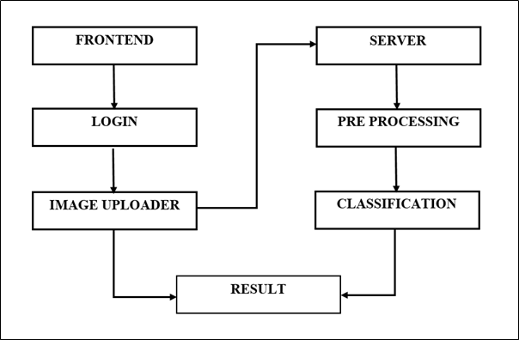
Block Diagram

Slide 7
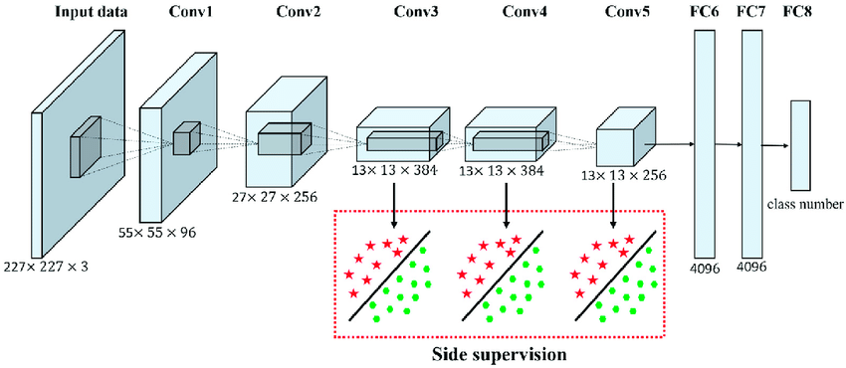
Alexnet Architecture

Slide 8
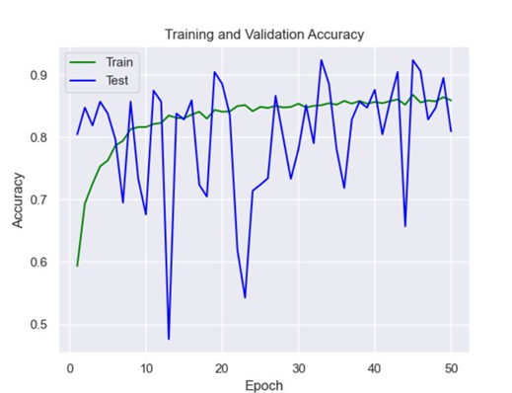
Training and Testing Accuracies

Slide 9
LITERATURE SURVEY
STUDY | NO OF SAMPLES | TECHNIQUES | ACCURACY
Farooq et al. | 2813 | COVID - ResNet | 96.23 %
Ali et al. | 100 | ResNet50 | 98 %
Minaee et al. | 5100 | Deep - Covid | -
Wang et al. | 13975 | CNN | 93.3 %
Kumar et al. | 50 | RestNet50 + SVM | 95.38 %
Apostolopoulos et al. | 1427 | VGG19 | 98.75 %
Oh et al. | 502 | ResNet18 | 88.9 %

Slide 10
TECHNICAL STACK
OPERATING SYSTEM | Windows 10
SOFTWARE PACKAGE | Pycharm Professional
DATABASE | SQLite
LANGUAGE | Python
BACKEND FRAMEWORK | Django
FRONTEND | Django Templates
LIBRARIES | Torch vision, Torch, Matplotlib, Numpy, Python Image Library (PIL)

Slide 11
PHASE 1 - TIMELINE
GOALS | DESCRIPTION | COMPLETION DATE
Problem Statement study & analysis | Problem statement was studied in depth, various possible solutions were analyzed. optimized solution was proposed. | Nov - 1
Dataset Collection | Reference from Kaggle / data science repositories. | Nov - 5

Slide 12
GOALS | DESCRIPTION | COMPLETION DATE
Concept study | A study was done on how to interpret data from x-rays manually and how the same can be done to detect covid-19. X-rays of patients tested with Covid positive and covid negative were used to test the understanding. | Nov - 10
Domain Study | Various basic concepts of Machine Learning & Deep learning were studied and analyzed. CNN algorithm was finalized for the project. | Nov - 18
Data Preparation | Data set format was changed . Images were segregated into folders. | Nov - 25

Slide 13
GOALS | DESCRIPTION | COMPLETION DATE
Environment Setup | Necessary softwares were installed. Packages and libraries were analyzed and finalized packages and libraries were installed. | Nov - 30
Implementation - Image Preprocessing | Image preprocessing is implemented | Dec - 18
Paper Publication Works | Paper references were collected and organized | Dec - 21

Slide 14
PHASE 2 - TIMELINE
GOALS | DESCRIPTION | COMPLETION DATE
Survey Paper Publication Works | Our Project related papers were analyzed and survey paper was prepared . | Jan 20
Training the dataset | Data set was trained using Machine learning algorithms to predict the results. | Feb 15
Testing the model | The model was tested for accuracy. | Feb 25
Main Paper Publication works | The main paper on our proposed system was prepared. | Mar 7

Slide 15
GOALS | DESCRIPTION | ESTIMATED TIME OF COMPLETION | MAN HRS
Paper Submission | Further improvements on paper to be done after the guide review and the same should be submitted. | 1 weeks | 105
Django project set up | Development environment should be set up. | 1 week | 105
Backend Implementation | Django Backend should be implemented for entire tested model. | 4 weeks | 420
Frontend Implementation | User interface should be implemented. | 4 week | 420
Testing | Entire application should be tested. | 1 week | 105
Further improvements |  | Based on the requirement.

Slide 16
PRESENTED BY:
Naveeth Z A - 17BIT031
Shinta C - 17BIT033
Janani Sri - 17BIT056
GUIDED BY:
Dr. Thirumal P C

Slide 17
THANK YOU

